Slide 1

AI in Cybersecurity
AI is a double-edged sword
Why?
Cause it has more brain cells then us :) to detect threat faster than us.
And gives us better advises than we do
Companies invest heavily in AI security solutions to stay ahead of hackers
But hackers use AI as well ;-;

Slide 2
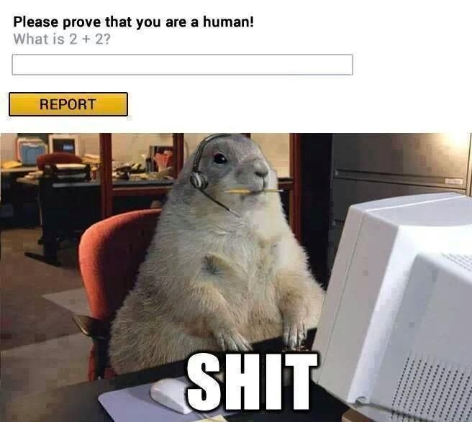

Slide 3
Well....
BUT JASON WHAT ABOUT THE JOBS!!

Slide 4
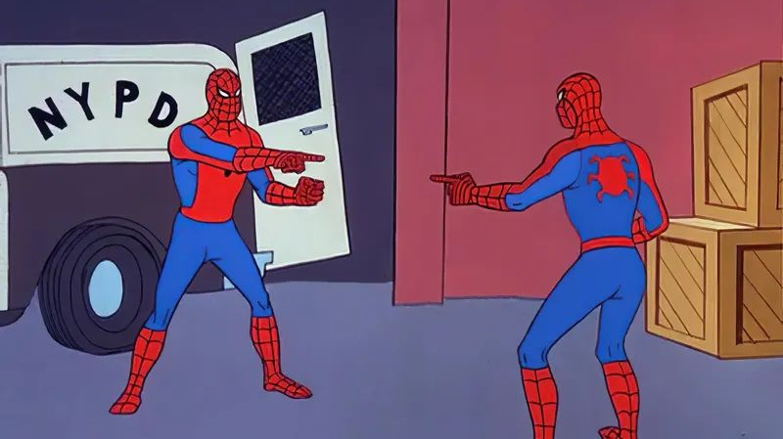

Well..
Luckily not many companies will risk only AI driven tech.. That includes banks and hospitals and even smaller businesses etc…
Its damn expensive
Plus nothing can go without the watch of a human
It also means that we need to learn AI to think like one and predict its steps.
So its pretty much like this
AI
AI

Slide 5
Let’s talk about the advantages of AI in cybersecurity .
AI can really quickly analyse large amounts of data in short amount of time.
Detecting anomalies and vulnerabilities is done as close to real time as possible .
Automating same processes
The potential of using AI in cybersecurity is virtually endless.

Slide 6
THANK YOU!!

Slide 7


RUNNING FOR THE TREASURER!!
Vote me
Jason Dsouza

